Slide 1
Descriptive and inferential statistical methodologies have proven effective in creating a proactive ‘alarm’, accurately identifying Pump Failures with Horse Power (HP) and Pump Efficiency (PE) emerging as key variables of interest with deviations of 3 HP and > 15 % PE being our core signal thresholds.
The first slide we want to show is our overall conclusion showcasing that we have been able to effectively create a multivariate regressive equation that models Pump Failure.
On this slide, we would like you to show two charts: A) Using a line-series chart, show the Multivariate Regression Equation Values you’ve developed versus the Pump Failure (1 or 0)
B) Using a Column Chart, show the correlations ranked from highest-to-lowest for the Rolling Standard Deviation Dataset
Hint: The Chart you’ve created for the Inferential Statistics Tab, Q8 may be helpful.
You’ve created the chart for B) in Q6 so feel free to re-use this.
We’ve included an example on the right for the line chart and what it may look like.
Note: We’ve included a sample headline for you – you can feel free to use this or modify this as you see fit

Slide 2
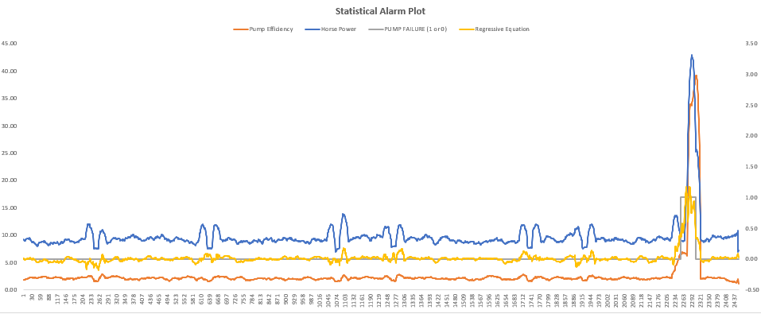
Descriptive and inferential statistical methodologies have proven effective in creating a proactive ‘alarm’, accurately identifying Pump Failures with Horse Power (HP) and Pump Efficiency (PE) emerging as key variables of interest with deviations of 3 HP and > 15 % PE being our core signal thresholds.
Note: We’ve included a sample headline for you – you can feel free to use this or modify this as you see fit

Slide 3
Descriptive Analysis has enabled us to clearly identify particular signature abnormalities showing clear signature changes in both Rolling Standard Deviation and Rolling Mean Datasets when observed over the respective failure period of interest.
Note: We’ve included a sample headline for you – you can feel free to use this or modify this as you see fit

Slide 4
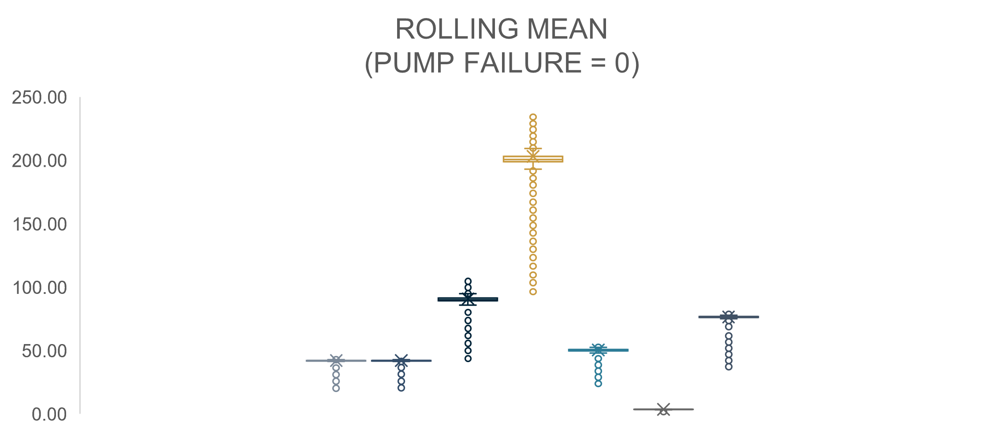
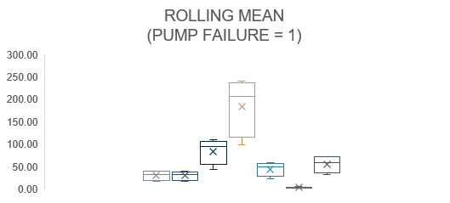
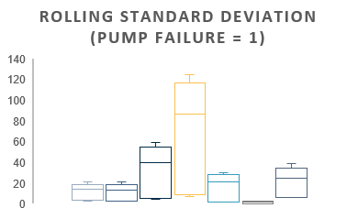
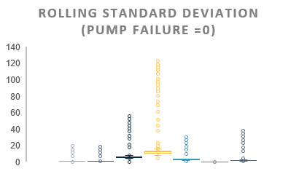
Further segmentation of the data via binary means (Pump Failure = 0 or 1) illustrated through Box Plots, show a clear signature difference between that of normal behaviour and that of Failure with Pump Torque, Pump Speed, Ambient Temperature showing the 3 largest variances.
Note: We’ve included a sample headline for you – you can feel free to use this or modify this as you see fit

Slide 5
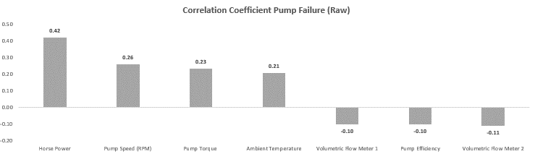
Correlation analyses across datasets yield interesting insights with Volumetric Flow Meter and Pump Efficiency negatively correlated with Pump Failure in the Rolling Mean Data, whilst Horse Power and Volumetric Flow Meter show a subsequently strong Positive correlation in the Rolling Stdev Dataset.
Note: We’ve included a sample headline for you – you can feel free to use this or modify this as you see fit

Slide 6
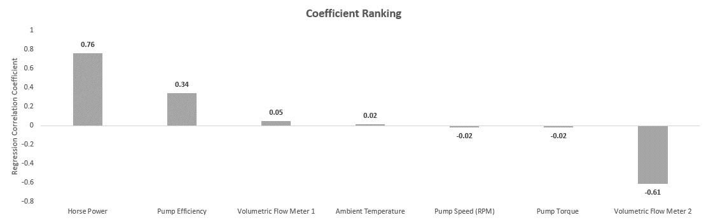
Lastly, analysis of the model fit reveals that with a R Squared of 0.77, a linear model is relatively a good fit for the data with variables X, Y and Z having the largest coefficients, indicative that these variables have the most immediate relationship with respect to Pump Failure behaviour.

